Slide 1
Conditionals

Slide 2
Zero Conditional
The Zero conditional is used for things that are always true as long as the condition is met.
Form:
[if + present simple], [present simple]
Example:
If you heat water until 100 degrees Celsius, it boils.
If I drink too much coffee, I get a headache.

Slide 3
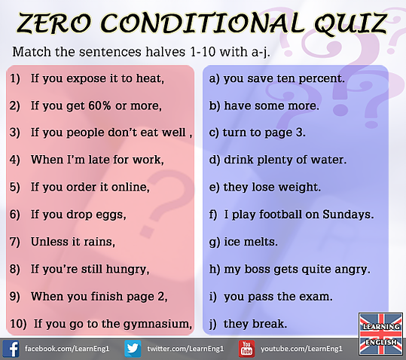

Slide 4
First Conditional
The First Conditional is used to predict the result of a future action (things which might happen in the future).
Form:
[if + present simple], [will + infinitive]
Example:
If she gets good grades, she will go to university.
You’ll fail the exam if you don’t do more work.

Slide 5
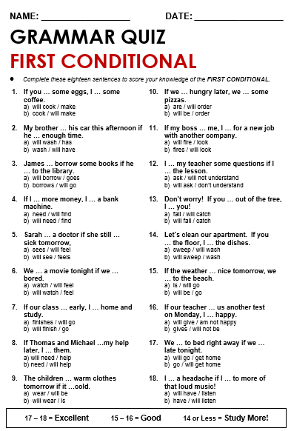

Slide 6
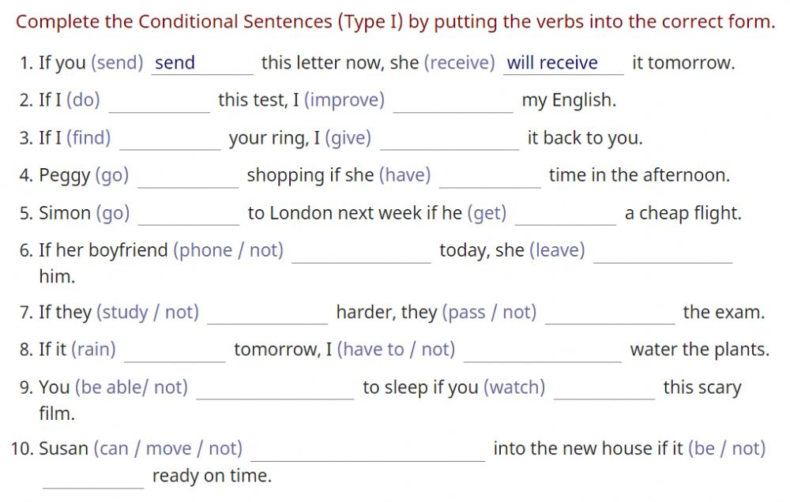

Slide 7
Second conditional
The Second conditional is used to talk about situations that are unlikely or unreal. It can refer to the present or the future.
Form:
[if + past simple], [would + infinitive]
Example:
If I were you, I wouldn’t do it.
I would learn Italian, if I had the time.

Slide 8
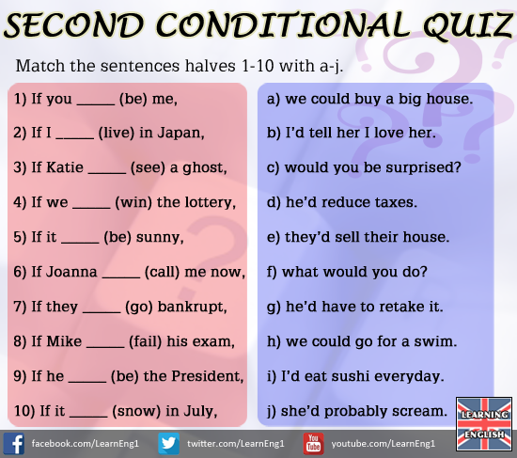

Slide 9
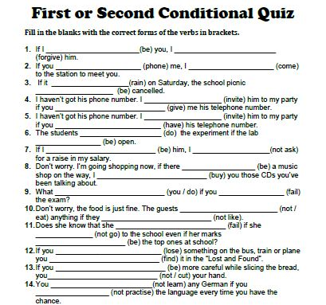

Slide 10
Third Conditional
The Third Conditional is used to speculate about the imaginary result of things which didn’t happen.
Form:
[if + past perfect], [would have + past participle]
Example:
If you had studied harder, you would have passed your exams.
We wouldn’t have been late, if we hadn’t missed the bus.

Slide 11
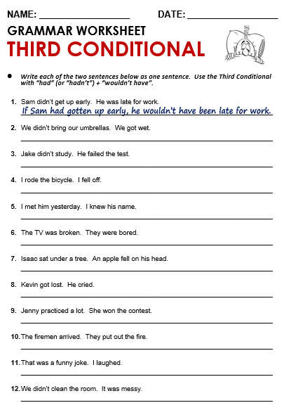

Slide 12
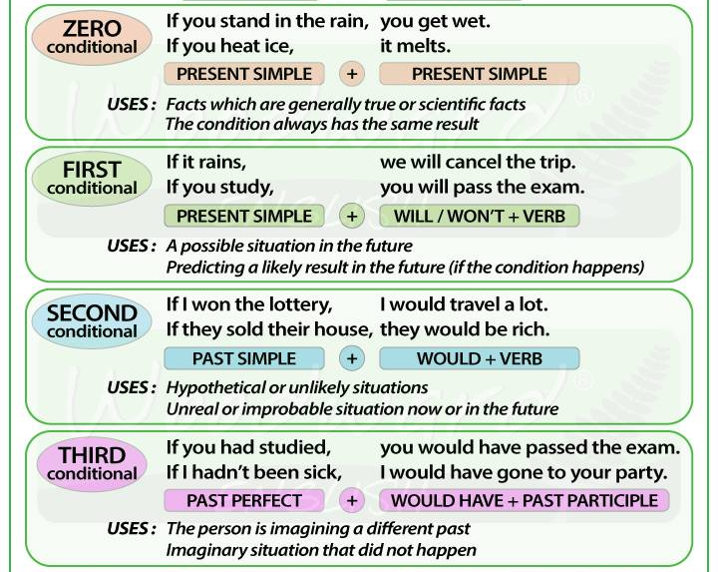

Slide 13
Practice makes Perfect!
https://www.englisch-hilfen.de/en/exercises_list/if.htm
http://www.myenglishpages.com/site_php_files/grammar-exercise-conditionals.php
https://www.ego4u.com/en/cram-up/tests/conditional-sentences-3
https://www.ego4u.com/en/cram-up/grammar/conditional-sentences

Slide 14
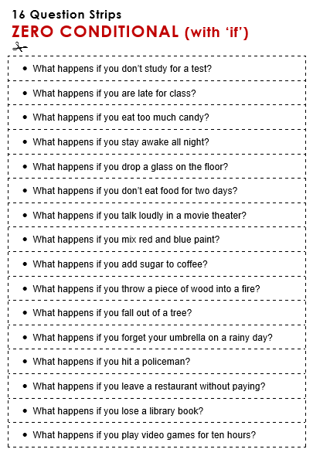

Slide 15
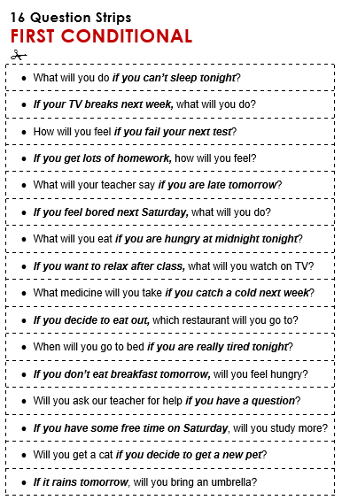

Slide 16
